Slide 1
Delivering Customer Experience with Big Data
Group 07:
Anshul Prakash
Brian Fernandes
Haoping Tan
Karunanidhi Devanidhi
Saikumar Mudaliar
November 08, 2016

Slide 2
Volkswagen’s Strategy 2018-
To become No. 1 in Global Automotive Industry
Expansion and recovery in North America
Product portfolio expansion
MARKET FOCUS
Increased market penetration
Emerging markets expansion
Balanced global ecological footprint
Leader in Customer Satisfaction
Top Employer
Unit Sales >10 million per year
Group return on sales before tax > 8%
Product/Process optimization
Regional scale effects
Cost control
MODULAR TOOLKIT STRATEGY
Scalability and higher efficiency
Increased production flexibility
Reduced time to market
Notes:
Strategy 2018 focuses on positioning the Volkswagen Group as a global economic and environmental leader among automobile manufacturers.
Focus is particular on the environmentally friendly orientation and profitability of vehicle projects so that the Volkswagen Group has the right products for success even in more challenging economic conditions.
In addition, Volkswagen Group intends to increase the customer base by acquiring new, satisfied customers around the world.
Strategy is made up of four main goals:
deploy intelligent innovations and technologies to become a world leader in customer satisfaction and quality
increase unit sales to more than 10 million vehicles per year
improve its return on sales before tax to at least 8%
become the top employer across all brands

Slide 3
Challenges in achieving their Target
Company’s U.S. strategy
Head of VW’s works council - “The worm has to taste good to the fish, not the fisherman. Sometimes I have the impression that it’s the other way around with us.”
Strict quality orientation
More complex environment
Technological megatrends
Stronger competition
Higher capital requirements
Notes:
While the financial performance of the VW Group as a whole was impressive, the group recorded mixed results in the U.S. market. Localization strategies allowed VW to double its sales between 2009 and 2012. However, making cheaper models compromised cars’ perceived quality. For example, the company used less expensive plastics, and did not equip some new models with the independent rear suspension that provided the fun-to-drive feel for which VWs had become known. These changes frustrated some long- time VW fans. The brand also suffered from mediocre quality rankings. In J.D. Power’s 2013 initial quality study, the VW brand ranked below average, well behind Chevrolet, Honda, Toyota and Hyundai.
The head of VW’s works council and a member of the supervisory board openly criticized the company’s U.S. strategy, citing an anemic sales force and a lack of sufficient variety in its models. He also pointed out that there was a misalignment between the brand’s U.S. offerings and the tastes of the American drivers.
The environment is changing rapidly driven by external factors such as:
TECHNOLOGICAL MEGATRENDS: impacting business models and customer needs
HIGHER CAPITAL REQUIREMENTS: triggered by the need to build up new core competencies and even shorter innovation cycles
STRONGER COMPETITION: both old and emerging competitors
MORE COMPLEX ENVIRONMENT: as a result of stricter emissions legislation and greater market volatility

Slide 4
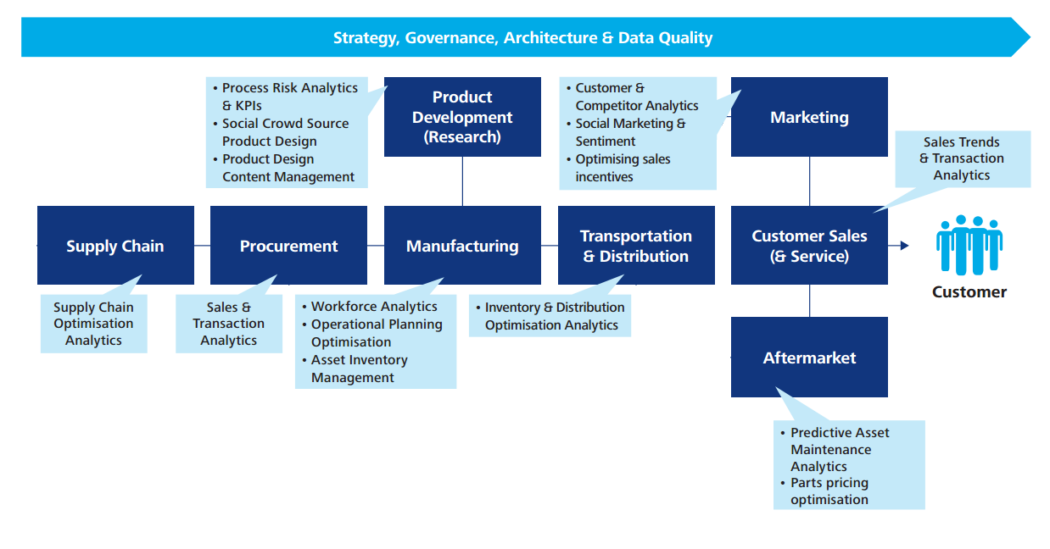
Big Data in the automotive industry
Source: Deloitte- Big Data and analytics in the automotive industry
Notes:
(Source: Deloitte- Big Data and analytics in the automotive industry)
Big data and analytics offer previously unthinkable possibilities for tackling cost pressure, competition, globalization, market shifts, and volatility and many other challenges Volkswagen face. As the automobile is being transformed by technologies, applications and services grounded in advances in everything from sensors to artificial intelligence to big data analysis; the ecosystem is witnessing a steady influx of new players and the continued evolution of the roles played by key stakeholders and the balance of power among them.
In automotive it has been embraced from a distance, inconsistently and has not always been well understood. The sheer scale of the data now available can appear intimidating but with the possibilities it affords it can no longer be ignored.
• The ability to harness data will enable masses of data to be utilised to form actionable customer segments and individualised offers and incentives to boost sales and improve customer retention;
• Applying statistical models to a mass of historical data from a range of sources can help to identify the impact of fixed and variable marketing investments and support automakers with a more precise and effective approach to quantity and composition of marketing spend;
• Supply chain data can reveal which links in a chain could weaken thereby allowing for proactive and timely countermeasures before a real problem manifests; and
• Predictive analytics can be used as a powerful tool for generating an enormous boost in forecasting efficiency as well as operations and performance.

Slide 5
Our proposed strategy
Consolidate data sources and leverage them to help VW in its 2018 strategy by facilitating:
Informed Product Design
Targeted marketing
Notes:
To fulfill the 2018 strategy, Volkswagen needs a holistic approach to focus upon all its internal functions. However, our proposal is to first use Big data analytics to improve product design and a more targeted marketing approach.
The growth in touchpoints and information available on customers is increasingly allowing VW group and dealers to focus on specific groups of customers with targeted messages and offers. This, together with the increasing volume and frequency of data available to track customer behaviour, offers an opportunity for a more precise approach to configure the optimal marketing and incentives mix for a targeted group of customers. However, the variety of data sources makes it difficult to collate and interpret the available information to understand the impact of different offers in a timely manner.
Those automakers that will be able to effectively manage and target their fixed and variable marketing spend to improve engagement and the appeal of their offers, will have a fantastic opportunity to improve customer engagement and drive sales through more targeted, informed and controlled marketing interventions.
The amount of data available can be daunting and they need to find a way of collating and analysing it so data driven decisions can be made.
Marketing analytics has the potential to significantly improve the decision making and returns they can deliver, by collating and analysing marketing information and customer behaviours in a consistent and seamless environment. Having done this, they can then begin to leverage historical data to gain some insight into which levers are best applied in which situations.

Slide 6

Data Sources: What we need
Brian Fernandes

Slide 7
Data Collection
Car servicing
Electronic servicing history
Customer feedback surveys
Insurance companies
Data brokers
Online surveys
Social media
Notes:
Where do we get all the required data from?
In order to implement our strategy we can collect or procure data from the following sources:
1. Car Servicing History
We will collect servicing information from all the service centers when customers service their cars. Collecting this information will help us identify the problems with our cars and the parts that frequently break down. The aim is to make servicing records completely electronic. This will help us easily store the information as well as analyze it for future needs. Useful information can be extracted which can then be used to improve our products.
Customers will also be asked to fill out feedback forms after the service. The forms will ask for feedback about the performance of the car and the service.
2. Insurance Companies
We can partner with insurance companies to get information about Automobile insurance claims. Insurance data will help us identify industry wide problems with automobiles in our target segment and identify purchase patterns of customers.
3. Data brokers
In addition to data collected from insurance firms, we will also purchase data from 3rd party data brokers such as Lexis-Nexis solutions who sell data collected from various sources to companies. This data can be credit ratings of individuals, demographic information and location specific information. This information can be analyzed and can help us design new products, target customers and help us deliver the right product to the right customer as per their requirement.
4. Online Surveys
We will use online surveys to receive feedback about our products from the public via online surveys and feedback forms. Customers will be asked to give their opinion on various product designs and features. The surveys will ask for people’s opinion on different designs for products, user preferences and features that people would like to have in a car.
5. Social Media
Social media is a growing source of real time customer feedback. We aim to provide customer support via social media such as Facebook and Twitter. We will use listening tools and sentiment analytics techniques complemented with human intelligence to provide such real time support.
The social media strategies can be combined with key performance indicators(KPIs) to improve ROI and gain insights into our customer base.
For example, we can use analytics software to gauge consumer interest before the launch of a new product. We can use this information to decide if the event must go ahead or if more investment is needed for marketing the product.

Slide 8
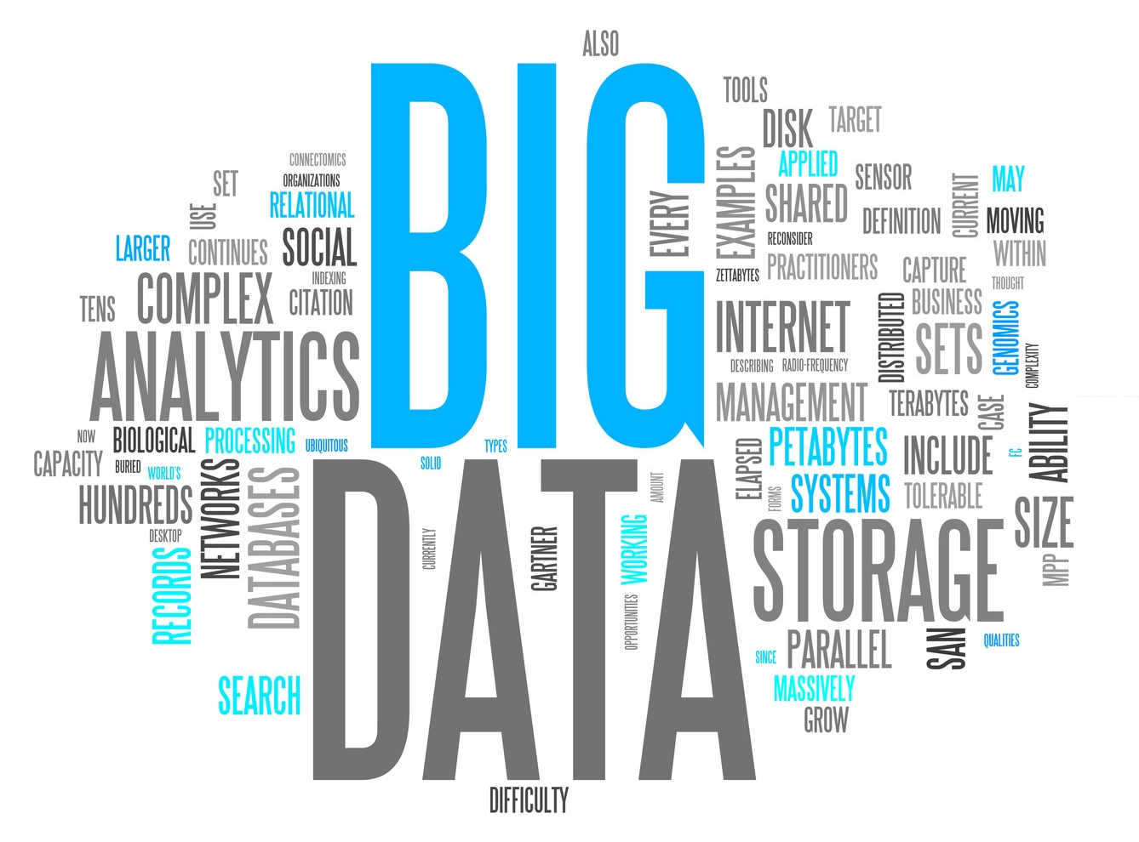
Leveraging Big Data at VW
Saikumar Mudaliar

Slide 9
The proposal at a high level
Consumer profiling
Servicing & Insurance History
Social Media and Smart surveys
The Right Car and the Right Customer
Notes:
Volkswagen has plenty of opportunity to further its market position. VW has exposure to almost all segments of cars and different regions across the world. Presence and experience of operating in different regions places VW in a vantage point from where it can asses the huge amount of data and take informed decisions. Surveys suggest that the people in US generate the largest amount of data every day. Since VW’s US operations is a big area of improvement, venturing into Big Data would be a good initiative.
Servicing & Insurance Information
Based on servicing and insurance history of a customer, VW can gain insights into his/her annual expenditure on car maintenance, type of car and budget, age of the current car etc. Besides, this data would reveal the common concerns the customer has about their car. Combining all this information together, VW Sales team can identify people who might be looking to buy a new car, draw comparisons backed with annual savings, customized maintenance schemes etc. Thus, this data would equip VW Sales team with compelling arguments in their efforts to boost sales.
Consumer profiling
Access to data about a consumer such as financial position, interests, style preferences etc. and easy availability of such data would reveal insights into the type of car a certain customer would like to buy.
Social Media and Smart Surveys
Analyzing social media and gathering more information through smart surveys would add to the richness of data at VW and help in understanding the market sentiment.

Slide 10

Targeted Marketing: The Right Customer
Increasing loyalty among existing customers
Targeting owners of cars of other brands
Identifying potential car buyers
Image courtesy: Digitalmarkgroup.com
Notes:
Targeted Marketing: The Right Customer
The performance of VW in the US so far suggests that they do not seem to have identified their own strengths, nor what customers would want to see in a new car. Better customer profiling and market sentiment analysis would help bridge this gap. The advantage of Big Data can be captured against each of the following segments of customers:
Existing customers:
Better insights into what prompted existing customers to buy a VW car, what they liked about their cars, and things they found wanting in them would be crucial for VW. It will help VW retain customers through timely promotions of newer model of cars they suit their preferences.
2. Owners of cars of other brands:
Similarly, VW can try to eat into the customers of competitors by drawing comparisons and benefits of switching over to a new VW car instead of their existing cars.
3. Potential car buyers:
Big Data would equip VW with the capability to identify potential car buyers such as new professionals, students, etc. through data about their credit history, salaries, city of residence, etc.

Slide 11
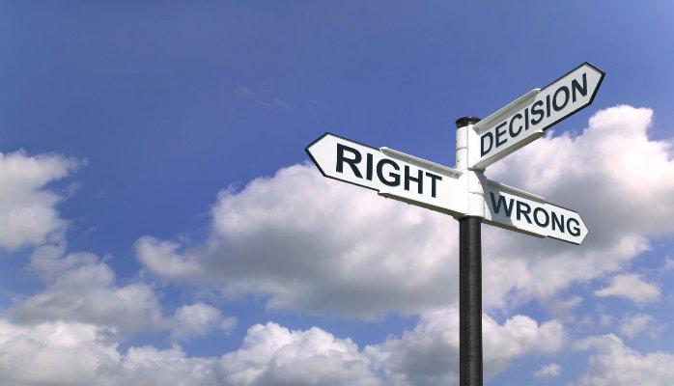
Informed design decisions: The Right Car
Building a “People’s car” through identification of
People’s perception of good and bad design
Things liked about VW cars
Things liked about competitors’ cars
Expectations from a future car
Source: goo.gl/q39Qo9
Notes:
Informed design decisions: The Right Car
Big Data would provide intelligence about the customers, the market, and evolution of the market’s needs.
Invaluable insights about people’s perception of a perfect car for them can be obtained through:
Simple analyses of easily available data
Collecting specific data through smartly-designed and targeted surveys

Slide 12

Implementation Costs and ROI
Haoping Tan

Slide 13
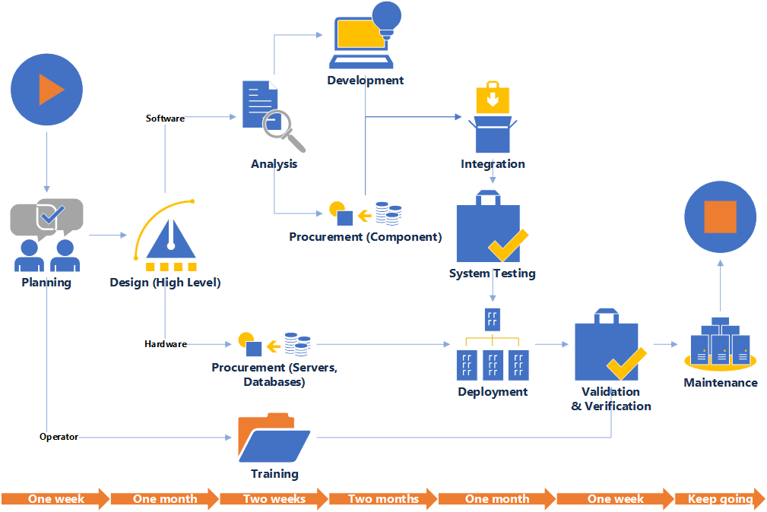
Implementation
Notes:
This is a implementation diagram that illustrate steps and timeline of system implementation. The upper part is the procedures we suggest VW to take to implement system. The lower part is the time that may take to finish certain procedure.
Planning: This process is to assign project participants, write proposal, get fund, and finish other necessary preparation to begin the project.
Design (High Level): This process is to design high-level architecture of the system, including hardware, software, operators and external systems.
Analysis: This process is to analyze the requirement of software to figure out what components VW needs, which one should we develop and which one should we procure.
Development: This process is to develop component. It includes other steps to make a required components.
Procurement (Component): This process is to select and procure component.
Integration: This process is to integrate components into a complete system.
System testing: This process is to test the completed system.
Procurement (Servers, Databases): This process is to purchase needed hardware, including servers and databases.
Deployment: This process is to install tested system to hardware.
Validation & Verification: This process is to test the whole system, including hardware, software and operators.
Training: This process is to train operators.
Maintenance: This process is for future development and upgrade.

Slide 14
Potential Benefits
Quantifiable:
Profitability can be increased by 5 - 6%
Marketing return on investment (MROI) can be increased by 15 - 20%
Unquantifiable:
Big Data analysis can reveal unexpected opportunities
Innovative ways can improve customer loyalty
Big Data can also offer process improvement insights
Notes:
The potential benefits VW could get include quantifiable and unquantifiable benefits.
The quantifiable ones include increase in both its profitability and marketing return on investment (MROI) because, with targeted marketing strategies, sales and customers feedback could be improved. The amount of increase might be hard to estimate but we compare VW’s condition with other similar companies to generate more accurate information. According to a research from Forbes, some companies have increased their profitability by 5-6 percent after the implementation of big data system. We expect VW to increase the same amount.
The unquantifiable ones include improvement in risk avoidance, loyalty and business process. With the analysis, VW could identify potential opportunities and risk that could enable it to take proper strategies. In addition, VW could have a direct marketing path to its customers and perform instance reaction on their problems, increasing loyalty through the efficiency of service. Although these improvements do not have a direct impact on the balance sheet, they could be beneficial in long-term.
Reference: http://www.forbes.com/sites/mckinsey/2013/07/22/big-data-analytics-and-the-future-of-marketing-sales/#1f04de03344d

Slide 15
Cost estimates: Some numbers
Hardware
Procurement | $55,125,000
Installation | $3,307,500
 |  | $58,432,500
Software
Development | $1,036,500
Procurement | $1,500,000
Others | $500,000
 |  | $3,036,500
Training | $1,168,000
Deployment | $100,000
External data center | $50,000
Marketing | $1,500,000
Redesign | $10,000
 |  | $2,828,000
Total |  | $64,297,000
Notes:
This table is the cost estimate to implement the big data system and related systems.
The procurement price is calculated based on the price of Microsoft server and database. Different vendors could have various prices on servers and databases. We picked some largest vendors and average their price as our standard. Price of installation of hardware is estimated based on the number that VW may need to install for the system.
The price of developing the system is based on estimates of the price of components and the salary of engineers. We also use the average method to figure out approximate number of the price.
Other costs, including training, deployment, external data source and marketing, are estimates that based on other companies.
http://ieeexplore.ieee.org/stamp/stamp.jsp?arnumber=5718216

Slide 16

Limitations & Future Scope
Karunanidhi Devanidhi

Slide 17
Limitations
Risk Mitigation
Data accuracy and reliability
Processing large amounts of data
Privacy issues and Government regulations
Extracting useful trends to target customers
Data collection from trusted sources
In-house data processing for better control
Human specialists to augment trends from big data
Notes:
Data accuracy and reliability : The state of completeness, validity, consistency, timeliness and accuracy that makes data appropriate for a specific use.
Processing large amounts of data : As data volume increases, the question of internal consistency within data becomes significant, regardless of fitness for use for any particular external purpose
Privacy issues and Government regulations : FTC has asserted vigorously its authority to apply existing consumer protection laws to emerging developments in the realm of information technology. The commission "will continue to monitor areas where big data practices" could violate those laws "and will bring enforcement actions where appropriate," it said in a report issued this year.
Extracting useful trends to target customers: Big data alone will reveal only a portion of the full picture. Big data gives us a bird's eye view: it points out patterns in the field. These patterns are indicative of something- but what is the thing driving those patterns?

Slide 18
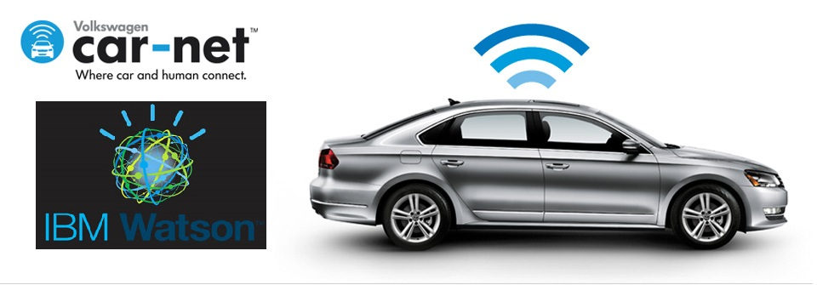
Future Scope
Cognitive mobility platform
On average, people in the U.S. spend more than 46 minutes per day in their car and are looking for ways to optimize their time
By leveraging Car-Net’s connectivity and combining it with the power of Watson, we are looking to provide safer, simpler, and better solutions to make our customers’ mobility experience more valuable and productive.
Notes:
Car-Net with Watson equips vehicles with machine learning capable of identifying information about the car and its surroundings. It could recognize when the car is low on fuel, identify nearby refilling stations, send a signal to the pump in the station to activate it, and then let the driver pay directly from their dash.
In addition to providing practical information on things like refueling locations, weather, and traffic, Car-Net can get personal as well. Through Watson Personality Insights and Watson Conversation APIs, the program can build associations with a driver’s favorite brands, identify the locations of their favorite coffee shop, and even connect to their social network.
Watson will learn your preferences, apply machine learning and sift through data to recognize patterns in your decisions and habits. With this information, marketers will offer services and suggestions that personally impact you.

Slide 19
Questions?
Thank you!

